Slide 1



General Ledger Training
Cloud Ellucian Colleague
Updated November 2019

Slide 2
Table of Contents
Accounting System: Ellucian Colleague
Chart of Accounts
GL Inquiry in Colleague (ACBL, AHST)
Online Repository Reports (GL0010, GL0210)
GL Reports in Colleague (GLSA)

Slide 3

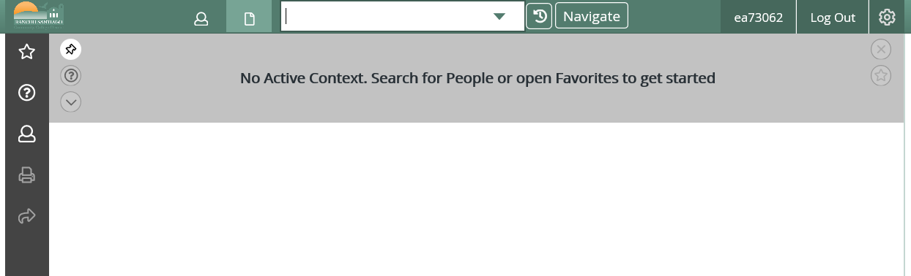
Accounting System: Ellucian Colleague
Enter/approve purchase requisition
Check the available budget for an account
Run budget to actual expenditure reports
Functions are accessed by entering the acronym for the desired screen in the search box

Slide 4
Common Colleague Acronyms
REQM – To enter a purchasing requisition
APRN – To approve purchasing requisitions
ACBL – To check budget/actual activity for a single account in the current fiscal year
AHST – To check budget/actual activity for a single account in the current or a prior fiscal year
GLSA – To run budget to actual reports
PINQ – To lookup an existing purchase order (items accepted, PO balance remaining)
VENI – To lookup existing requisitions, purchase orders, and payments for a specific vendor

Slide 5
Chart of Accounts
The Chart of Accounts is an index of all the financial accounts in the District’s general ledger. It is used to classify and segregate expenses and revenues into the appropriate categories for financial reporting.
Each GL account has 5 components (Fund, Project, TOP, Department, Object) for a total of 21 digits.
This is an example of a GL account:
11-0000-672000-54212-4610
Fund | Project | TOP | Department | Object
XX | XXXX | XXXXXX | XXXXX | XXXX
2-digits | 4-digits | 6-digits | 5-digits | 4-digits

Slide 6
Chart of Accounts (cont.)
FUND
  Identifies the major source and use of funds. Unrestricted funds are discretionary in nature. Restricted funds are for a specific purpose.
  Most commonly used funds
    11 – General Fund Unrestricted
    12 – General Fund Restricted
    13 – General Fund Unrestricted One-Time Funds
PROJECT
  Identifies the specific purpose of the funds. Only used when we need to track specific funds, including the associated revenues and expenses, separately as is the case with grants, parking, health services.
  1xxx – Federal Projects
  2xxx – State Projects
  3xxx – Local Projects and or District designations

Slide 7
Chart of Accounts (cont.)
TOP
  Classification of expenditures by activity reflects the purpose of the expenditure.
  It shows the aspect of college-district operations benefited by the expenditure.
  TOP codes below 600000 are used for instructional expenditures.
  TOP codes 600000 or greater are used for non-instructional expenditures.
DEPARTMENT
  1xxxx – SAC department
  2xxxx – SCC department
  5xxxx – District Office department

Slide 8
Chart of Accounts (cont.)
OBJECT
  Classification of expenditures by object reflects the type of expenditure. There are 7 major expenditure types (also called categories).
  1xxx – Academic Salaries
  2xxx – Classified Salaries and Other Nonacademic Salaries
  3xxx – Employee Benefits
  4xxx – Supplies & Materials
  5xxx – Other Operating Expenses & Services
  6xxx – Capital Outlay
  7xxx – Other Outgo

Slide 9
Chart of Accounts (cont.)
  A current Chart of Accounts is posted online on the Fiscal Services webpage.
  https://rsccd.edu/Departments/Fiscal-Services/Documents/Chart_of_Accounts.pdf

Slide 10
GL Inquiry in Colleague: ACBL
TIP: We highly recommend using ACBL to check for available budget before preparing a Budget Change or Purchase Requisition!
ACBL can help you:
  Verify that an account exists and the status of the account (e.g. open or closed) in the current fiscal year.
  Lookup the budget and availability of funds for a single account in the current fiscal year.
  View budget changes that have posted to an account in the current fiscal year.
  View actual expenses (including TOEs) that have posted to an account in the current fiscal year.
  View approved PRs and POs that have encumbered funds in the account in the current fiscal year.

Slide 11
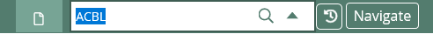
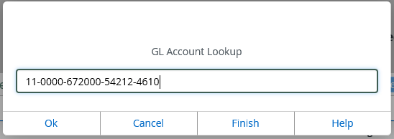
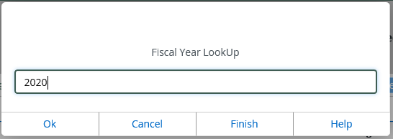
How to run ACBL:
1. Enter ACBL in the Search Box.
2. Enter the GL account number and click OK. Then enter the Fiscal Year and click OK.
TIP: You can enter the GL account number with or without dashes.
TIP: If you do not know all the segments of the GL account string, you can enter the segments you do know and use ellipsis for the segments you do not know. Do not use dashes. For example: “11…54212…4610…” Colleague will return one or more possible GL accounts for you to choose from.

Slide 12
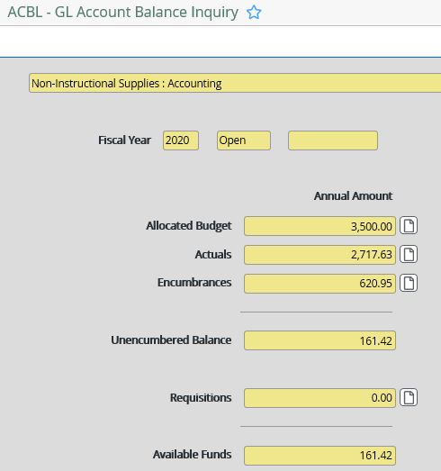
How to read ACBL:

Slide 13

How to read ACBL (cont.):
“Available Funds” indicates the amount of budget available to spend in the account. It is the allocated budget, less actual expenditures, less encumbrances, less requisitions.
“Allocated Budget” represents the budget for the account. It includes any budget changes that posted subsequent to the Adopted Budget.
“Actuals” represents actual expenditures that have posted to the account. This includes payroll costs or vendor payments depending on the account. It also includes any transfers of expenditure (TOEs) that have been posted.
“Encumbrances” represent a portion of the allocated budget that has been set aside for a particular expenditure(s). There are two types of encumbrances: payroll encumbrances and Purchase Order encumbrances.
“Requisitions” represents a portion of the allocated budget that has been set aside for a purchase requisition(s) which has not yet been turned into a Purchase Order.
TIP: You can click on the Document Icons to drill into the detail.

Slide 14
GL Inquiry in Colleague: AHST
AHST can help you:
  Lookup the budget and budget changes for a single account in a prior year.
  View actual expenses (including TOEs) that posted to an account in a prior year.

Slide 15
How to run AHST:
1. Enter AHST in the Search Box.
2. Enter the GL account number and click OK.

Slide 16
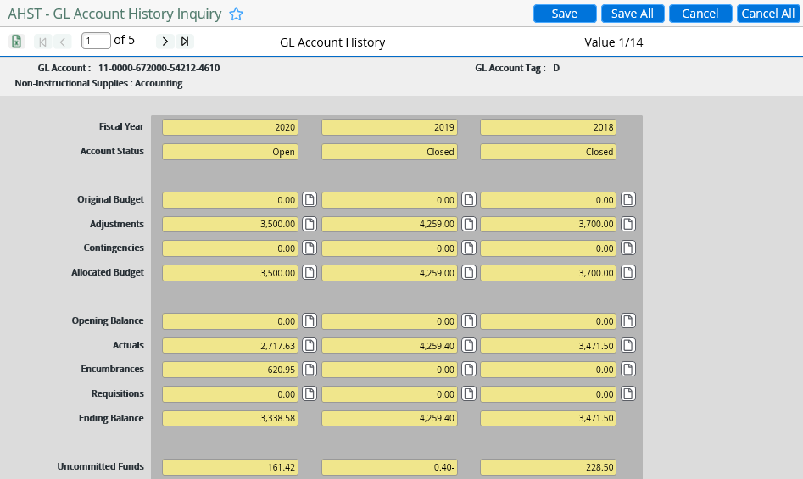
How to read AHST:

Slide 17
Online Repository Reports
GL reports on the Online Repository were designed in-house by our ITS Department and pull GL data from the Colleague accounting system.
Online Repository Reports are considered more user-friendly then running reports directly from Colleague.
To access the Online Repository:
Go to Employee Intranet > Online Forms Reports and Requests > “Online Report Repository”.
OR click on the following link https://reports.rsccd.org/colorsnetweb/
TIP: You can add this link to your bookmarks so it’s easily accessible.
TIP: When you login to the Online Repository make sure you are in the “Production” environment.
TIP: If you need access to a specific report and don’t have access, please send a request for access to helpdesk@rsccd.edu.

Slide 18
GL0010 Report
GL0010 can help you:
  Run a summary YTD budget to actuals report for your department or project. This report gives you a summary by account. Unlike ACBL and AHST, you can set report parameters so that your report includes multiple GL accounts, even multiple departments or projects.
  GL0010 reports are fiscal Year-To-Date and do not cross fiscal years.
  If you run a GL0010 report as of November 2019, the report will capture budget to actuals from July 1, 2019 through November 30, 2019.
  If you run a GL0010 report as of June 2019, the report will capture budget to actuals from July 1, 2018 through June 30, 2019.

Slide 19


How to run a GL0010 report:
1. Find “GL0010 Budget Recapitulation” and click on this report.
2. Click “Change to Regular Mode”. Regular mode is the easiest way to run a complete GL report for your department. Edit Mode can be used to run the report with additional parameters.
3. You will need to select/enter the report parameters to run the desired report. “Fiscal Year” defaults to current fiscal year but you can select a prior fiscal year from the dropdown. “Month End” defaults to the current month but you can select a different month from the dropdown.

Slide 20
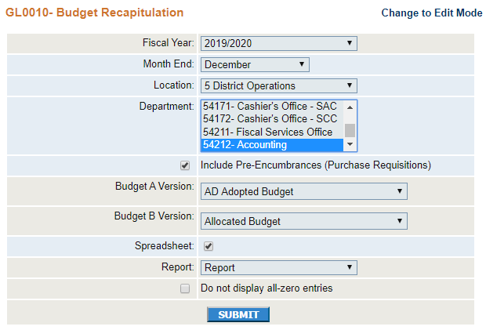
How to run a GL0010 report (cont.):
Report in Regular Mode
4. Select the Location from the dropdown. Select the Department(s) from the dropdown.
5. “Include Pre-Encumbrances (Purchase Requisitions)” is checked by default. We recommend leaving this checked so your report shows you an accurate picture of available funds.
6. Budget A Version and Budget B Version fields populate by default. The Adopted Budget is the budget that was Board approved in August/September. The Allocated Budget is the current budget including budget changes that have subsequently posted. We recommend using the default options so your report shows current budget information.

Slide 21
How to run a GL0010 report (cont.):
Report in Regular Mode
7. “Do not display all-zero entries” is checked by default. Uncheck this box if you’d like your report to include accounts that have a zero balance.
8. Select the Output Format for your report from the dropdown. You can select Report, PDF, or Word. You can also check “Excel Export” if you’d like the report in Excel.
9. Click submit.

Slide 22
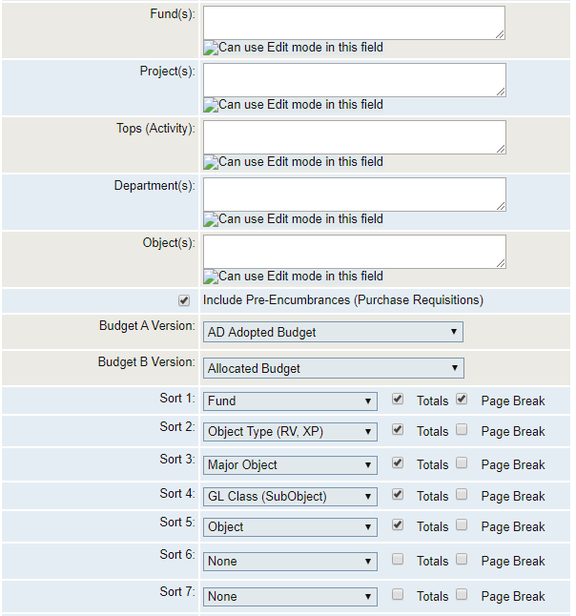
How to run a GL0010 report (cont.):
Report in Edit Mode
You can set additional report parameters by running the report in Edit Mode. Enter the Fund(s), Project(s), Top(s), Department(s), Object(s) you would like your report to include.
TIP: In any of these fields, you can enter a range. For example, in the Object field entering “4000-5999” will only return expenses within this range.
TIP: In any of these fields, you can also use “X” as a special character. For example, in the Object field entering “1XXX” will only return expenses that have an object code beginning with a “1” (academic salaries).
Sort 1 through Sort 7 allows you to sort the report, and set subtotals and page breaks as desired.

Slide 23
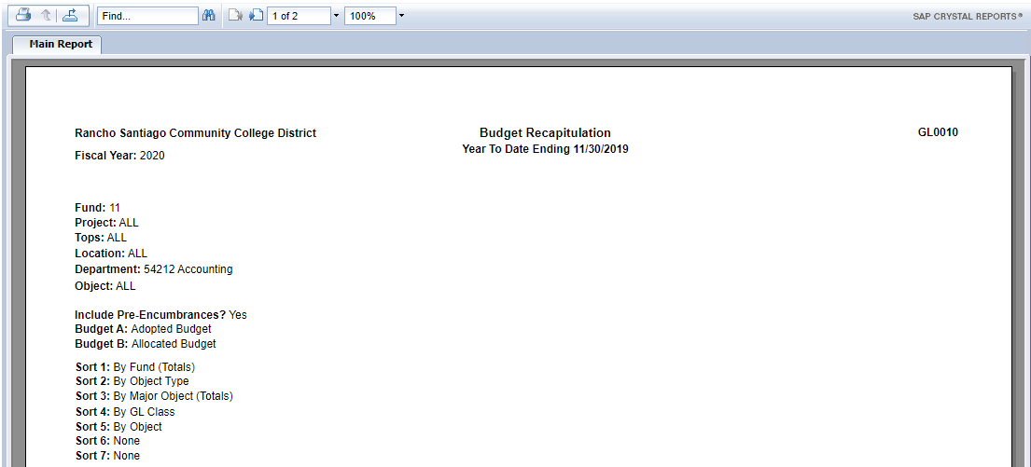
How to read a GL0010 report:

Slide 24
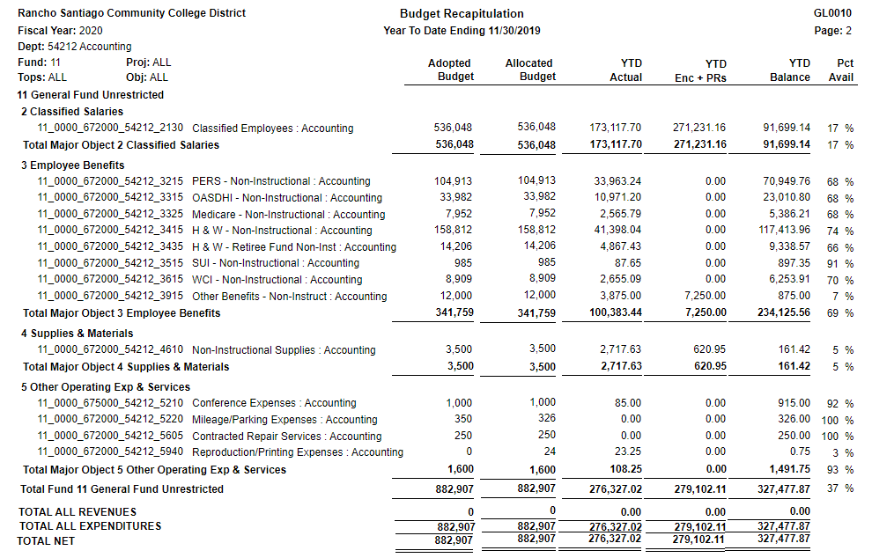
How to read a GL0010 report (cont.):
      A B C A - B - C

Slide 25
How to read a GL0010 report (cont.):
“Adopted Budget” is the budget that was Board approved in August/September.
“Allocated Budget” is the current budget including budget changes posted subsequent to the Adopted Budget.
“YTD Actuals” represents actual expenses. It includes any transfers of expenditure (TOEs) that have posted.
“YTD Enc + PRs” represents encumbrances and purchasing requisitions.
“YTD Balance” shows the amount of budget available to spend in the account. It is the allocated budget, less actual expenditures, less encumbrances and requisitions.
TIP: If a GL account has a negative “YTD Balance”, this indicates that the account is overspent. A budget change should be submitted to transfer budget to this account.
TIP: You can use ACBL to drill into account detail for a single account at a time. You can use a GL0210 report to drill into account detail for multiple accounts at a time.

Slide 26
GL0210 Report
GL0210 can help you:
  Run a detailed report on all actual expense activity, all budget activity, or all encumbrance activity. You can set report parameters so that your report includes multiple GL accounts. You can also run the report for a specific date range (but the date range cannot cross fiscal years).

Slide 27

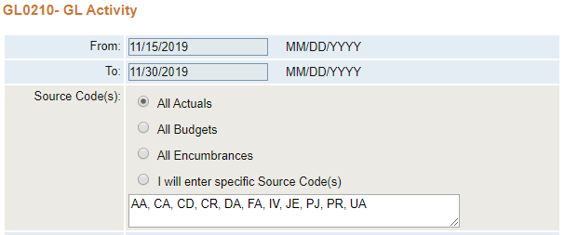
How to run a GL0210 report:
1. Find “GL0210 GL Activity” and click on this report.
2. Enter the date range to run the desired report. The date range cannot cross fiscal years.

Slide 28
How to run a GL0210 report (cont.):
3. Select “All Actuals”, “All Budgets”, or “All Encumbrances” depending on the report you’d like to run. All Actuals is all actual expenses.
You can also select “I will enter specific Source Code(s)” if you only want your report to include certain types of transactions.

Slide 29
How to run a GL0210 report (cont.):
Source Codes & Descriptions
Source Codes | Description | Applicable for Expenses:
AA | Opening Balance | No
CA | Capital Assets (Fund 51) | No
CD | Cash Disbursements | No
CR | Cash Receipts | Yes
DA | Capital Assets, Disposals (Fund 51) | No
FA | Financial Aid | Yes
IV | Invoices | Yes
JE | Journal Entries (TOEs) | Yes
PJ | Purchasing Journals (Vendor Payments) | Yes
PR | Payroll | Yes
UA | Capital Asset, Additions (Fund 51) | No
BU | Budget Adjustment | Yes
EP | Encumbrance | Yes

Slide 30
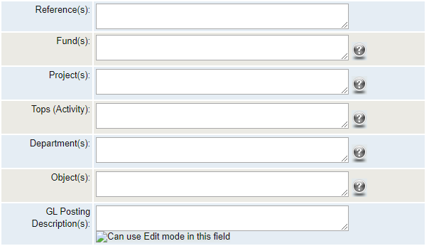
How to run a GL0210 report (cont.):
4. Enter the desired report parameters.
TIP: If you want to run a complete report for your entire Department, you can simply enter it in the “Department(s)” field. Leave all other fields blank.
TIP: If you’re looking for a specific transaction and know the reference number, enter it in the “Reference(s)” field. For example, V0712168 or CTPY2003B or CTPY2003BF or HWPY2003B.
TIP: In any of these fields, you can enter a range. For example, in the Object field entering “4000-5999” will only return expenses within this range.
TIP: In any of these fields, you can also use “X” as a special character. For example, in the Object field entering “1XXX” will only return expenses that have an object code beginning with a “1” (academic salaries).
TIP: If you want to run the payroll expense for a specific employee to prepare a transfer of expenditure (TOE), enter the employee ID in the “GL Posting Description”.

Slide 31
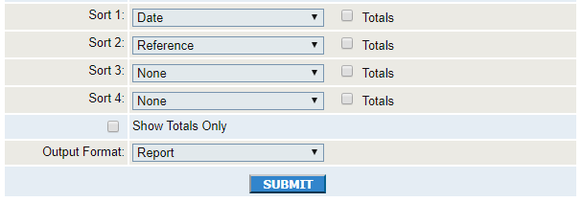
How to run a GL0210 report (cont.):
5. Sort 1 through Sort 4 allows you to sort the report, and set subtotals as desired.
6. Select the Output Format for your report from the dropdown. You can select Report, PDF, Excel, or Word.
7. Click submit.

Slide 32
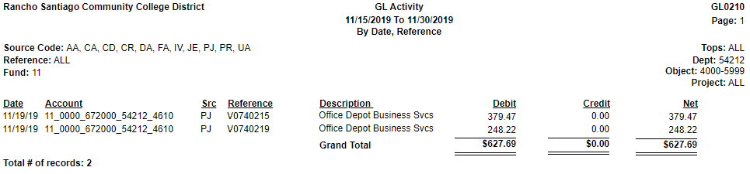
How to read a GL0210 report:
When running a report on All Actual Expenses, debits represent actual expenses that have posted to the account. Credits represent a reduction to expense; this could be due to a reversal or transfer of expense.
When running a report on All Budgets, debits represent budget allocated to the account. Credits represent a reduction to the budget; this could be due to a reversal or budget change.

Slide 33
How to read a GL0210 report (cont.):
References | Description | Example
Vxxxxxxx | AP Voucher (Vendor Payment) | V0712168
CTPYxxxxx | Payroll Salaries and Wages | CTPY2003B 20 represents fiscal year 03 represents pay cycle A represents the Certificated payroll B represents the Classified payroll
CTPYxxxxxF | Payroll Fringe Benefits | CTPY2003BF 20 represents fiscal year 03 represents pay cycle A represents the Certificated payroll B represents the Classified payroll
HWPYxxxxx | Payroll Health & Welfare | HWPY2003B 20 represents fiscal year 03 represents pay cycle A represents the Certificated payroll B represents the Classified payroll
Jxxxxxx | Journal Entries (TOEs) | J055394

Slide 34
GL Reports in Colleague: GLSA
GLSA can help you:
  Run a summary YTD budget to actuals report for your department or project in Colleague. This report gives you a summary by account. You can set report parameters so that your report includes multiple GL accounts, even multiple departments or projects.
GLSA reports are fiscal Year-To-Date and do not cross fiscal years.

Slide 35
How to run a GLSA report:
Enter GLSA in the Search Box.

Slide 36
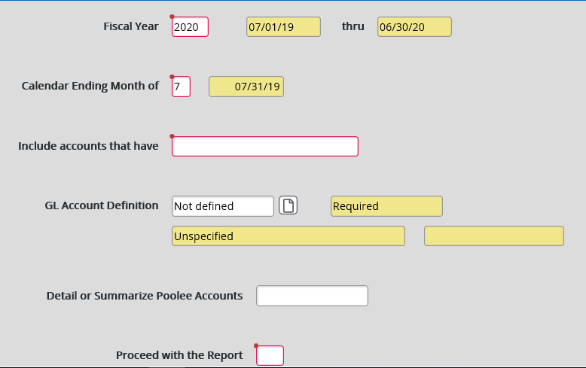
How to run a GLSA report (cont.):
Step 1 ->
Step 2 ->
Step 3 ->
Step 6 ->
Step 4 ->
Step 5 ->

Slide 37
How to run a GLSA report (cont.):
Step 1: Enter the Fiscal Year. The default is the current fiscal year but you can select a prior fiscal year.
Step 2: GLSA reports are fiscal YTD. Enter the number of the ending month.
Number | Month | Reporting Period
7 | JULY | 07/01/2019 – 07/31/2019
8 | AUGUST | 07/01/2019 – 08/31/2019
9 | SEPTEMBER | 07/01/2019 – 09/30/2019
10 | OCTOBER | 07/01/2019 – 10/31/2019
11 | NOVEMBER | 07/01/2019 – 11/30/2019
12 | DECEMBER | 07/01/2019 – 12/31/2019
1 | JANUARY | 07/01/2019 – 01/31/2020
2 | FEBRUARY | 07/01/2019 – 02/29/2020
3 | MARCH | 07/01/2019 – 03/31/2020
4 | APRIL | 07/01/2019 – 04/30/2020
5 | MAY | 07/01/2019 – 05/31/2020
6 | JUNE | 07/01/2019 – 06/30/2020

Slide 38
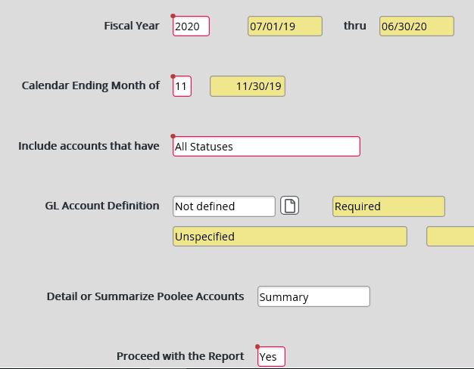
How to run a GLSA report (cont.):
Step 3: Enter “A” for All Statuses.
Step 4: Enter “S” for Summary.
Step 5: Enter “Y” for Yes.
Step 6: Click on the Document Icon.
This will open up another screen called GLSF00 “GL Standard List/Select” where you will need to enter the report parameters and sort specifications.

Slide 39
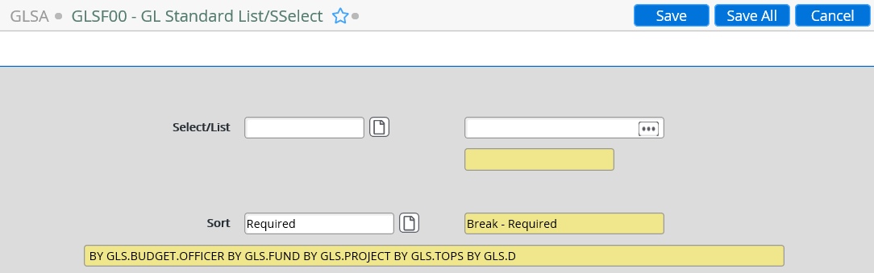
How to run a GLSA report (cont.):
Step 6a: Click on the “Select/List” Document Icon.

Slide 40
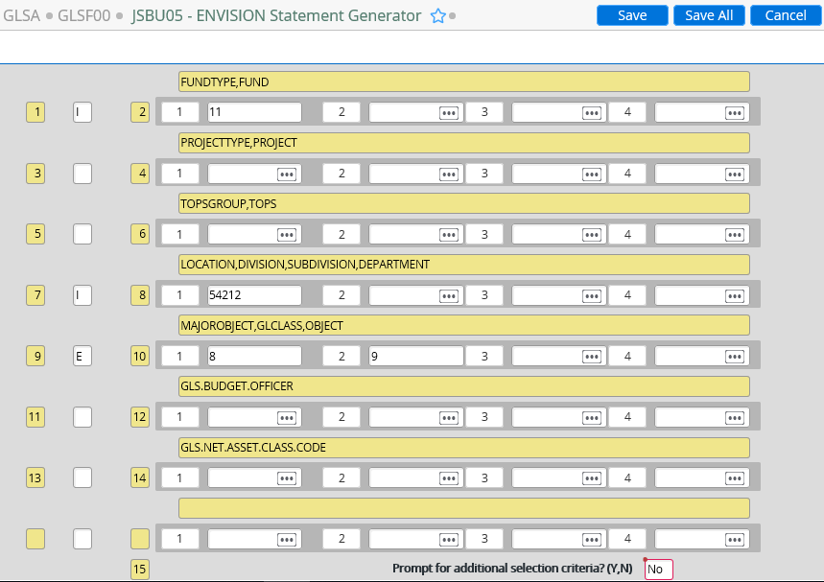
How to run a GLSA report (cont.):
Step 6a: For each report parameter, you will need to enter “I” for include or “E” for exclude. Then, enter the report parameter.
In this example, we’ve selected to include Fund 11, include Department 54212, and exclude all objects that start with “8” or “9”.
TIP: You can enter specific object codes (e.g. 4610) or the first digit of the object series (e.g. 4) for all objects that start with “4”.
Under “Prompt for additional selection criteria?” enter “N” for No.
Click Save.

Slide 41
How to run a GLSA report (cont.):
Step 6b: Click on the “Sort” Document Icon.

Slide 42
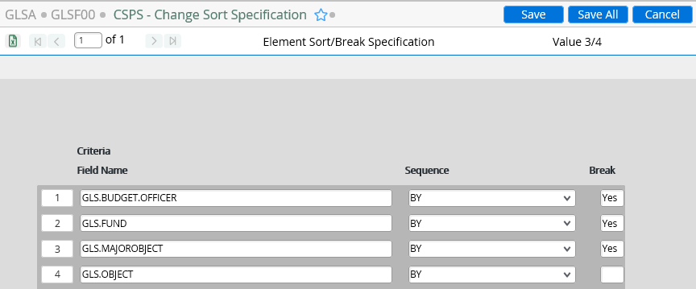
How to run a GLSA report (cont.):
Step 6b: Sort specifications auto-populate but you change the sort order and even delete sort elements.
Under Break, enter “Y” to set page breaks and subtotals.
Click Save.
TIP: In any of the Criteria fields, you can enter an ellipsis (…) to see selection options.

Slide 43
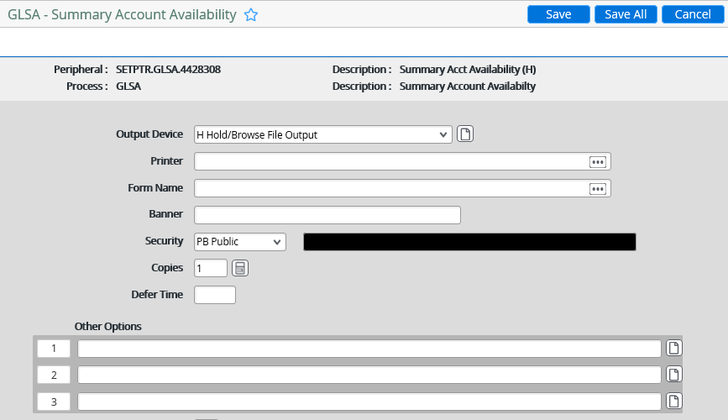
How to run a GLSA report (cont.):
Step 7: Keep clicking save and update until you get to this screen. Under Output Device, select “H Hold/Browse File Output” then click save.

Slide 44
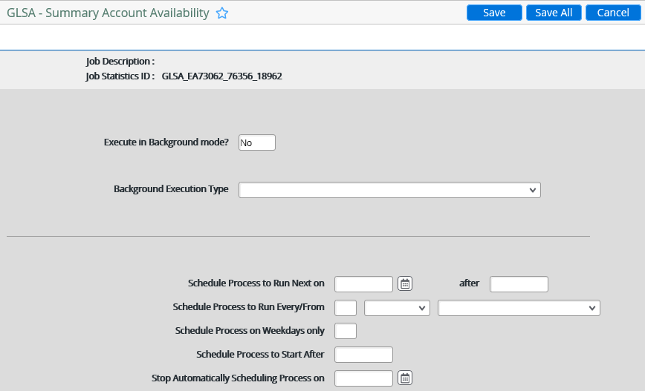
How to run a GLSA report (cont.):
Step 8: Keep clicking save and update until you get to this screen. Under Execute in Background mode, select “No” then click save.

Slide 45
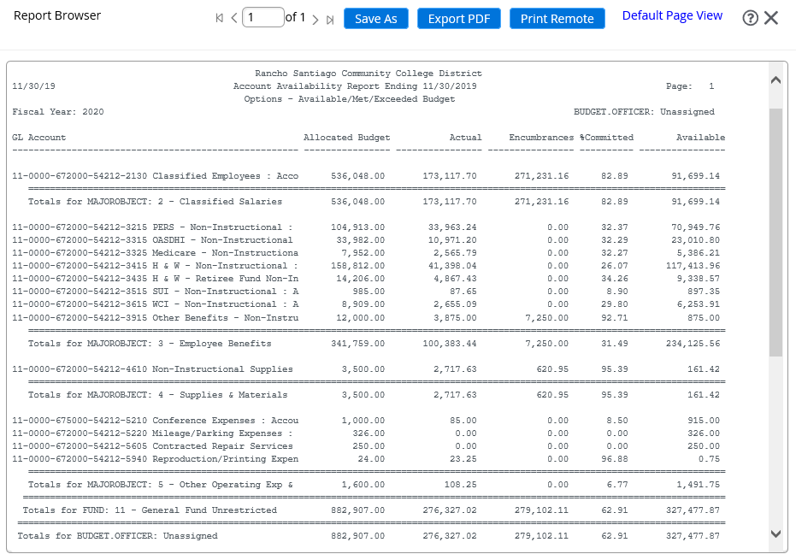
How to run a GLSA report (cont.):
Step 9: Click on “Export PDF”.
Recommended formatting options: Courier Font, 8 Font Size.
Then, click on “Create PDF”.
Then, click on “Download”.

Slide 46
Questions?

